Slide 1
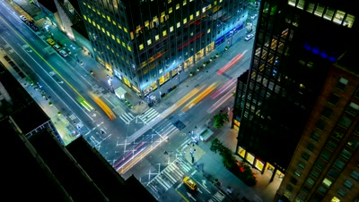
T1A3 PORTFOLIO
A WEBSITE STORY BY DANIEL KIM ©

Slide 2
FEATURES
About me
Portfolio/Projects
Blog Posts
CONTACT page
Link to all relevant socials, using their respective logo’s as buttons.

Slide 3
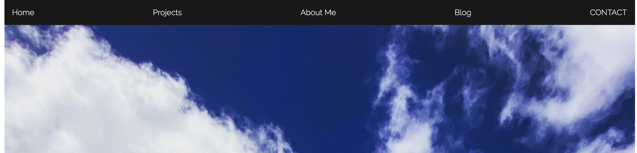
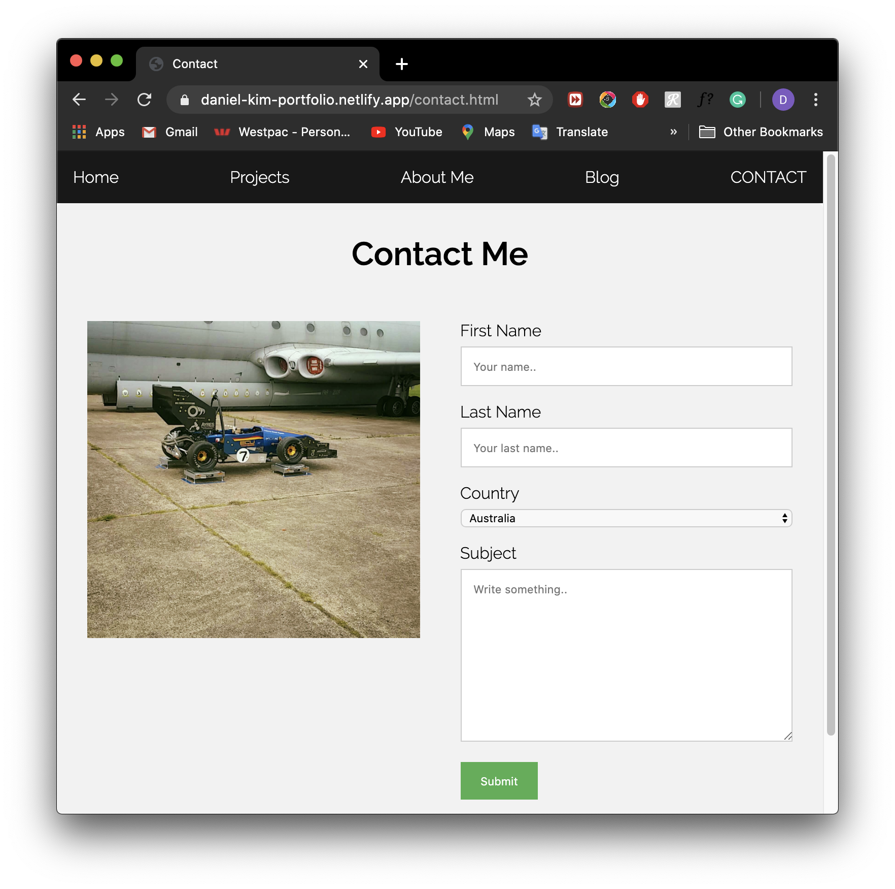
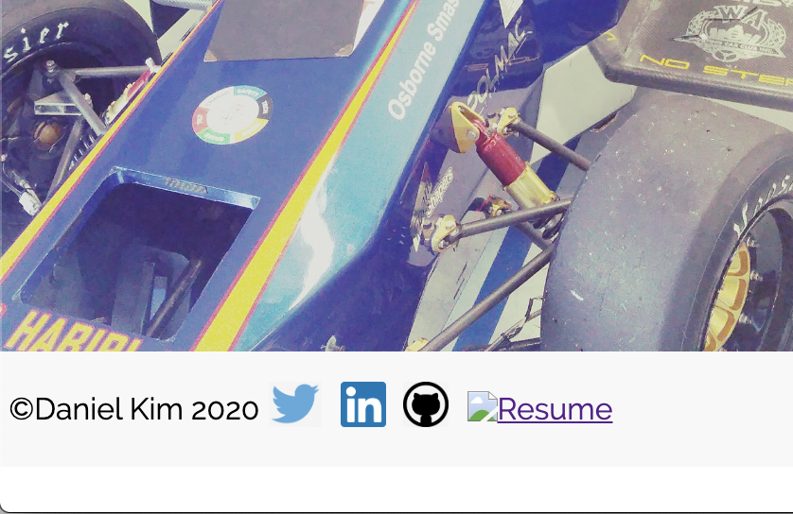
FEATURES

Slide 4
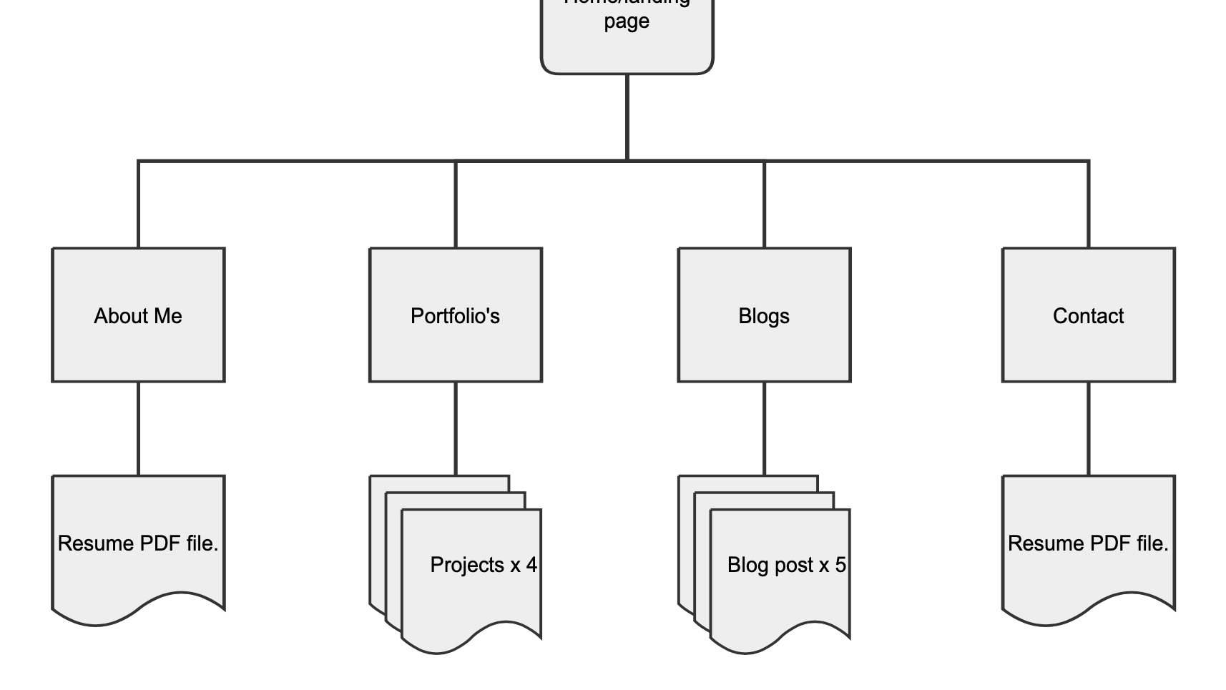
SITEMAP
PORTFOLIO WEBSITE

Slide 5
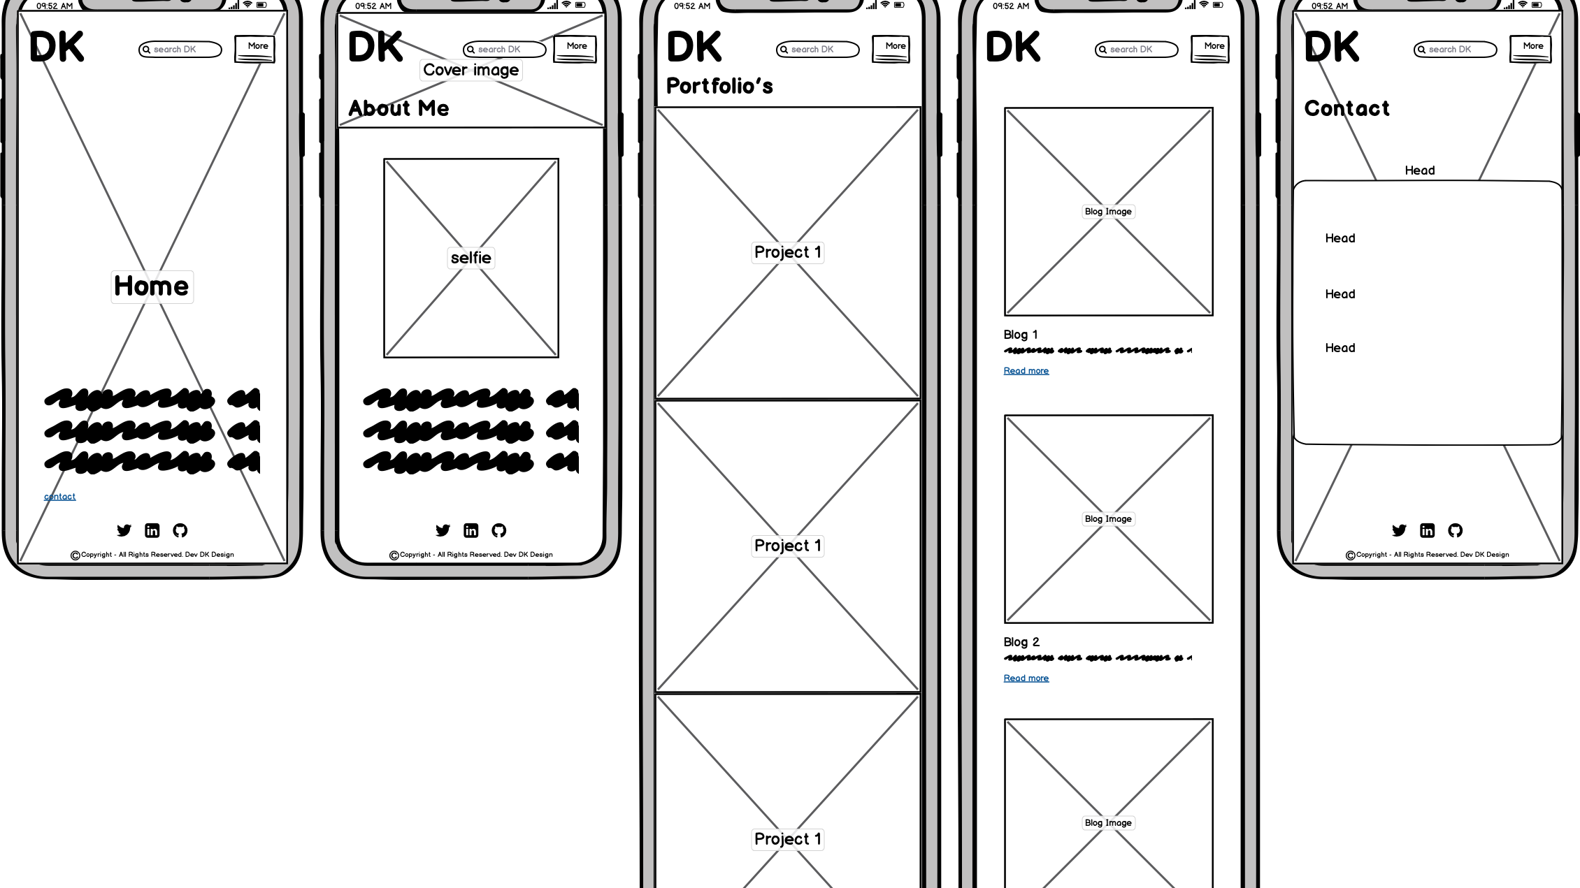
WIREFRAME-MOBILE

Slide 6
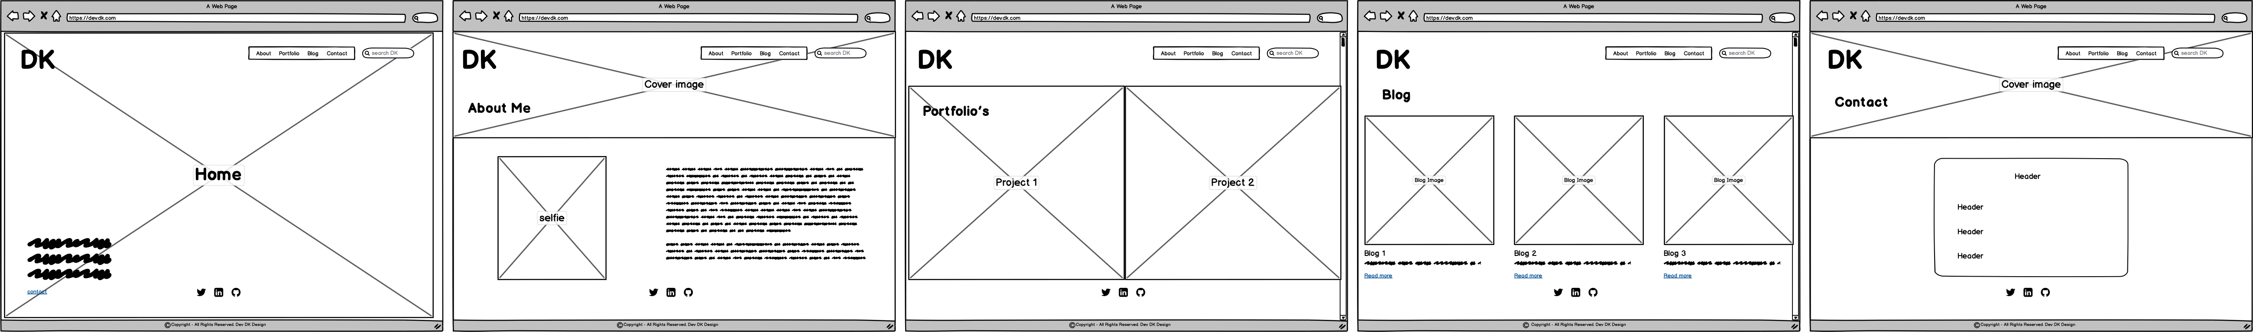
WIREFRAMES - DESKTOP

Slide 7
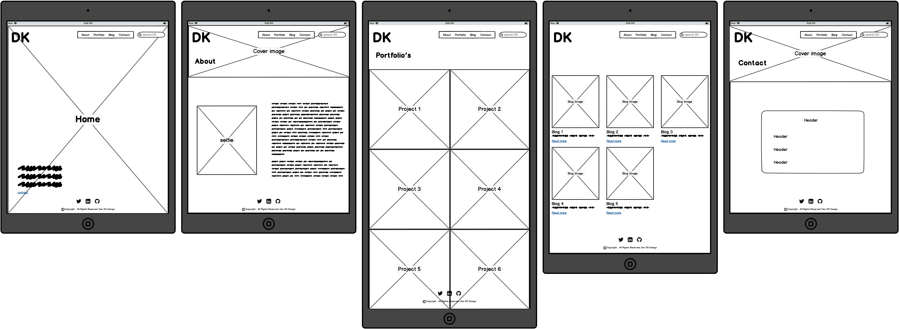
WIREFRAME - TABLETS

Slide 8
DESIGN PROCESS
PINTEREST – MOOD BOARD
DRIBBLE
PAST STUDENTS

Slide 9
REASONS
SIMPLE TO CODE (HOPEFULLY)
CLEAN/SIMPLE = PLEASANT UX
AIMING FOR ZERO LAG

Slide 10
COMPONENTS
WHITE SPACE – LOTS OF IT.
NAVIGATION BAR
MULTIPLE PAGES
WELL SELECTED TYPOGRAPHY FONTS
HIGH-RES IMAGES
STRATEGICALLY PLACED TEXT AND COVER PHOTOS

Slide 11
REVIEW
Realized very quickly, I su..need to practice HTML/CSS a HEAP more, and that my website will not end up how I imagined (wireframed) it to be.
BALANCING TIME BUDGET
Really enjoyed gaining inspiration from professional websites and then using wirify-ing? them☺

